Slide 1

EU & India - Dependency on Russia for energy products
Amol Sharma
10th November 2022

Slide 2
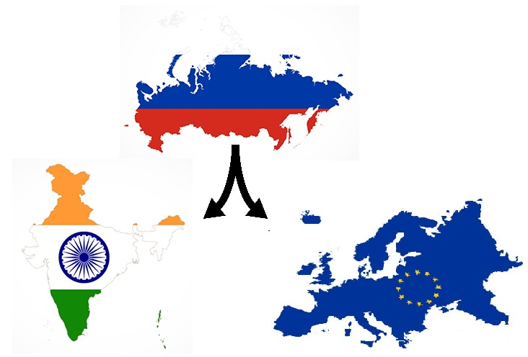
Background
2022 Russian invasion of Ukraine.
Subsequent Western calls to shun import of Russian
oil.
India, however, moving in opposite direction.
Accusations regarding India financing Russia’s war.
FM’s assertion regarding finding a balance between
interest (Russian imports) and values (moral dilemma)
Highlighted continued EU imports of Russian energy products.

Slide 3
Aim
To answer following queries :-
For European Union
EU wide trends in Production of Primary Energy by Fuel Type during 2010-2020.
EU wide Production of Primary Energy by Fuel Type in year 2020.
Across Europe which countries are Net Importers/exporters of energy products.
Decadal(2010-2020) trends in EU's dependency on Russia for Solid Fossil Fuel, Oil and Petroleum Products and Natural Gas import.
EU's top 5 sources of import for Solid Fossil Fuel, Oil and Petroleum Products and Natural Gas in last 5 years (2016-2020)
For India
India's top 5 sources of import for Crude in last 5 years (2017-18 to 2021-22).
Trends in India's crude import from Russia in last 5 years.
Comparison between India's crude import from Russia between April-August 2022-23 and April-August 2021-22.
Trends in India's coal import from Russia in last 5 years (2017-18 to 2021-22).

Slide 4
Remarks
Primary production of energy is any extraction of energy products in a useable form from natural sources. This occurs either when natural sources are exploited (for example, in coal mines, crude oil fields, hydro power plants) or in the fabrication of biofuels.
Transforming energy from one form into another, such as electricity or heat generation in thermal power plants (where primary energy sources are burned), or coke production in coke ovens, is not primary production.
Eurostat’s annual data series cover in principle all Member States of the European Union (27 countries), EFTA-countries (Iceland and Norway), EU candidate countries (Montenegro, North Macedonia, Albania, Serbia and Turkey) and potential candidate countries (Bosnia & Herzegovina and Kosovo). Data for Energy Community Contracting Parties are also available (in addition to countries listed before this covers Moldova, Ukraine and Georgia).This study restrict itself to EU (27 countries).
As on 10th November 2022, the latest data available pertains to
Yearly data up to 2020 for European Union.
Financial Year wise data up to Apr-Aug 2022-23 for India.

Slide 5
Methodology
Gather authentic, up-to-date data regarding
European Union – Eurostat.
India Tradestat ,
Directorate General of Commercial Intelligence and Statistics (Principal commodity level data)
Using Numpy and Pandas, perform Exploratory Data Analysis to know the trends.
Illustrate the findings using Matplotlib and Seaborn.

Slide 6
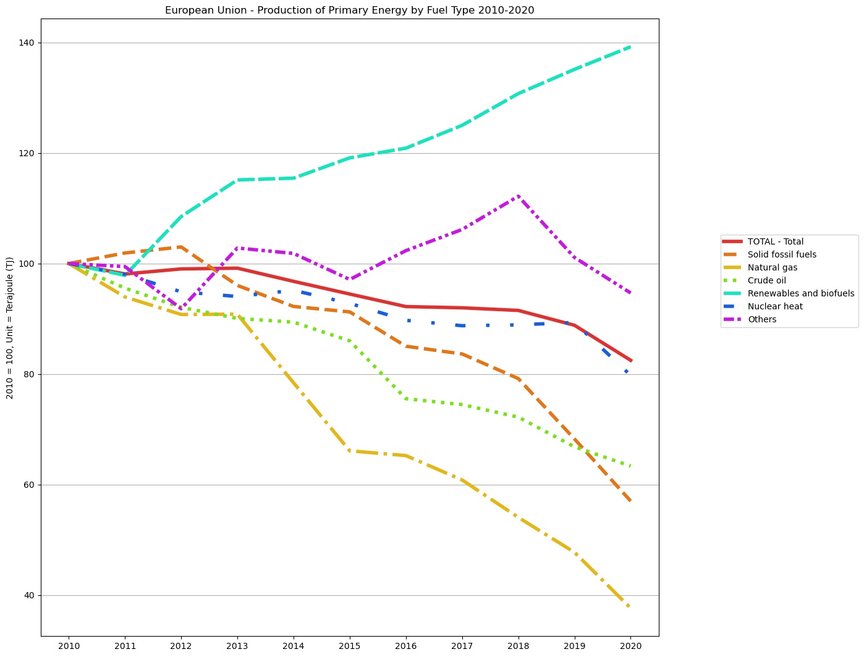
Results
1.
Over the past decade (2010-2020), the trend in primary energy production for EU was generally negative for solid fossil fuels, oil, natural gas, and nuclear energy. Renewable energy accounted for highest share and the positive trend is in line with EU’s climate change policy.
The continuous decrease in primary energy production domestically means increasing use of imports to fill this gap.

Slide 7
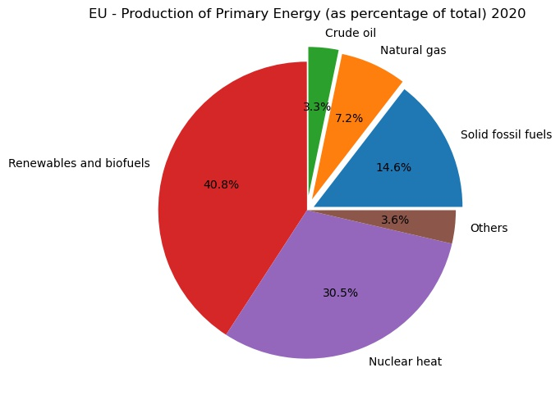
2.
Share of fuel type in EU’s primary energy
production
Renewables and Biofuels 40.8%
Nuclear Heat - 30.5%
Solid Fossil Fuels - 14.6%
Natural Gas - 7.2%
Crude Oil - 3.3%
Others - 3.6%
Out of fuel mix , 25.1% are hydrocarbons
where domestic shortfalls are fulfilled
with imports.

Slide 8
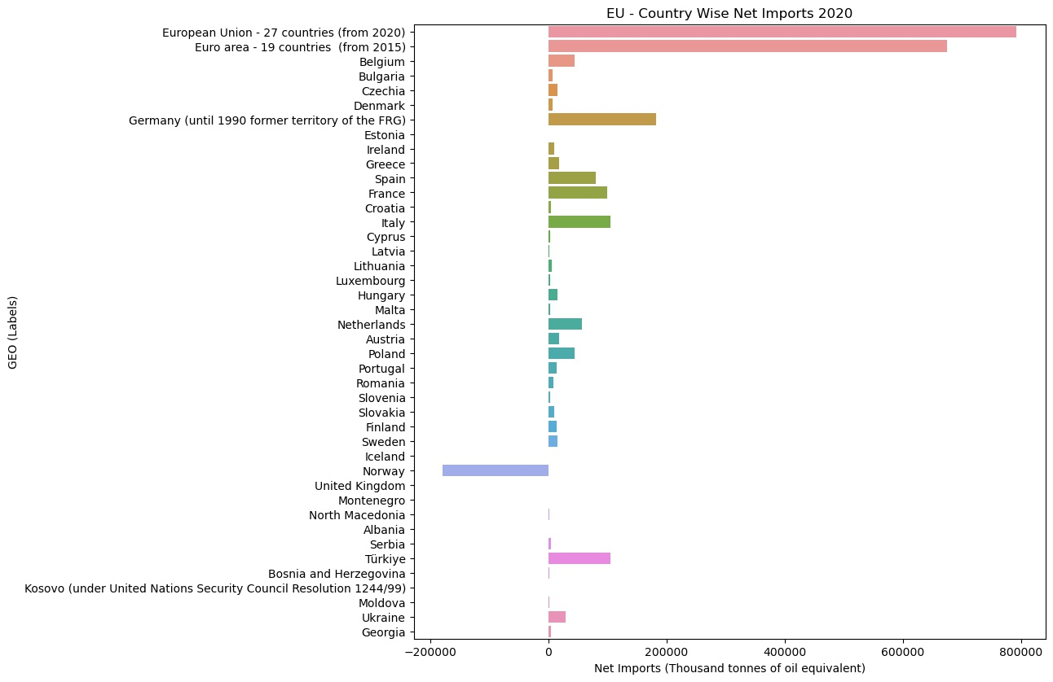
3.
The figure shows
Europe wide
country wise net
imports of energy
products in 2020.
Except Norway,
whole of Europe
is net importer
of energy products
Among EU member countries, Germany, Italy and France are respectively the biggest net importers (largely in trend with being the 3 biggest economies inside EU)

Slide 9
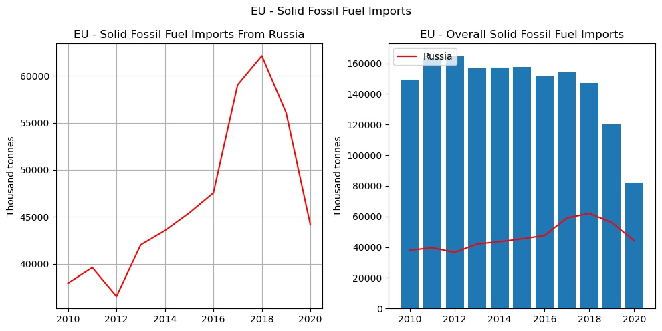
4.
While use of Solid Fossil Fuel for energy production has decreased in recent years, this trend is not visible in imports from Russia.
In 2020, Russia accounted for more than half of all Solid Fossil Fuel (mostly coal) imports by EU.

Slide 10
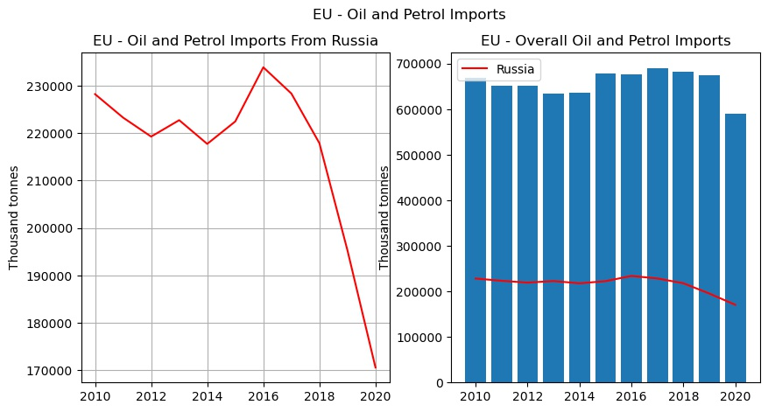
5.
Oil and petrol imports from Russia are continuously declining from 2016 to 2020.
In 2020, Russia accounted for almost three quarters of the extra-EU crude oil imports.

Slide 11
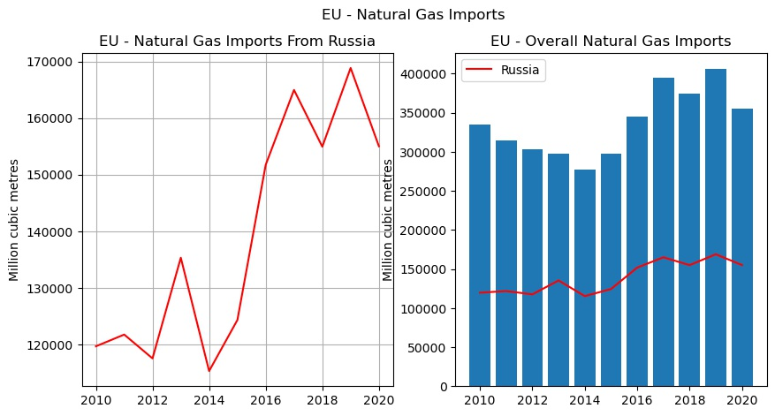
6.
During past decade (2010-2020), almost one third of EU’s Natural Gas imports were from Russia.
Russia accounted for around 42% of all Natural Gas imports in 2020.

Slide 12
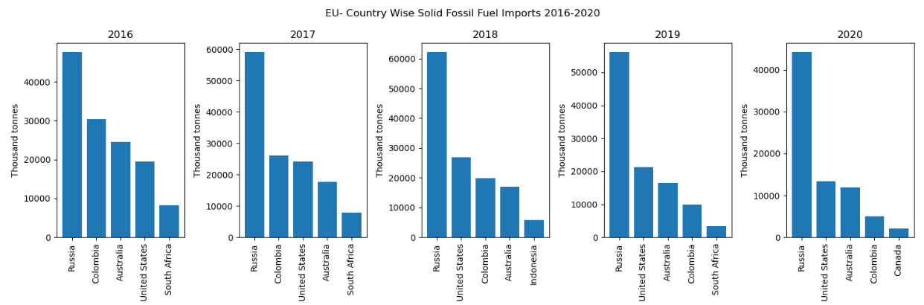
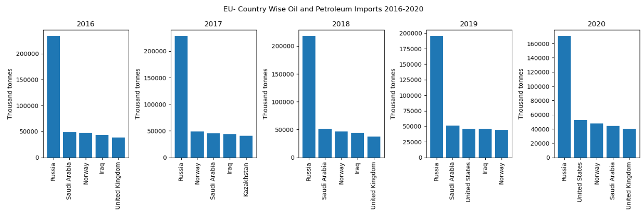
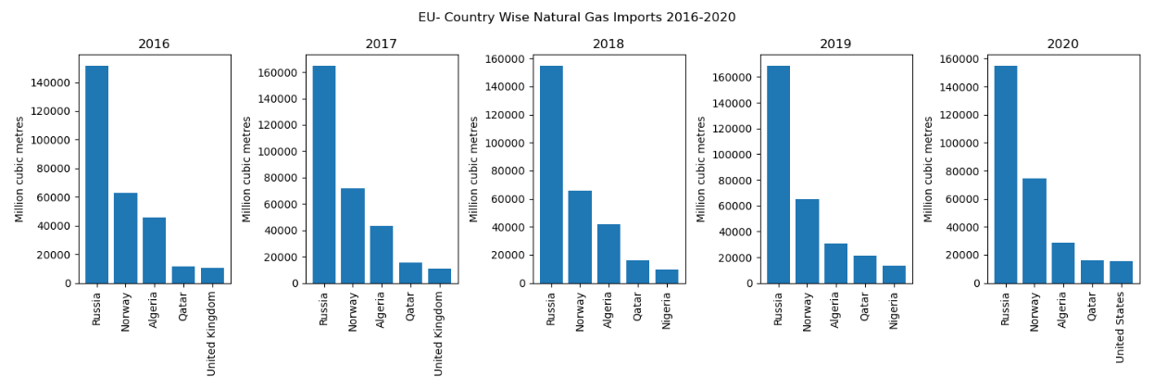
7.
The graphs show top 5 sources of import for Solid Fossil Fuels, Oil & Petroleum and Natural Gas for EU during period 2016-2020.
The largest share by far is consistently from Russia across all 3 products.
This is largely expected due to transportation economics.

Slide 13
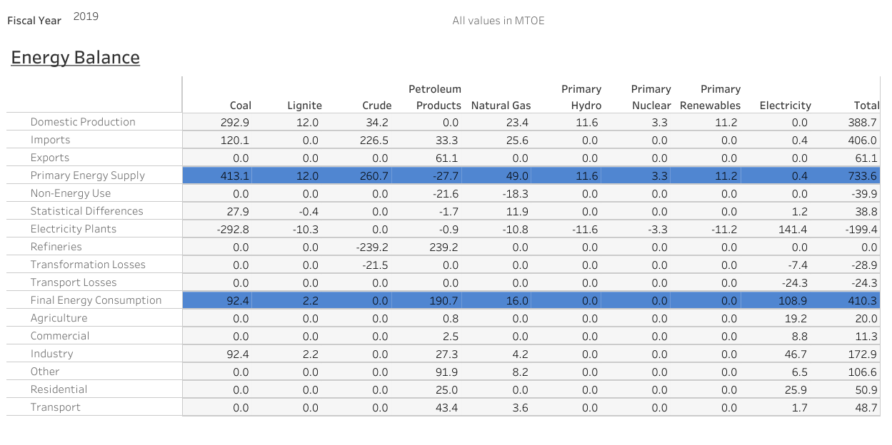
8.
For India, NITI Aayog’s India Energy Dashboard shows:-
India’s energy needs are largely met by two fuels – coal and crude.
Coal (domestic + import) alone accounts for 56.31 % of total primary energy supply.
Crude, 55.79 % of all energy product import, accounts for 35.53 % of total primary energy supply.
Rest of primary energy mix is comprised of Natural Gas, Lignite, Renewables and Nuclear energy.

Slide 14
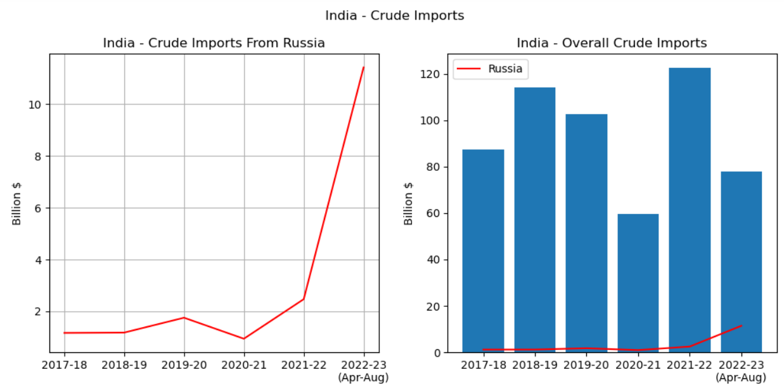
9.
Russia’s share in India’s crude oil import basket has been negligible over last 5 years with a sharp increase seen during Apr-Aug 2022 period.
Still, Russia accounted for only 14.6% of India’s crude imports in Apr-Aug 2023.

Slide 15
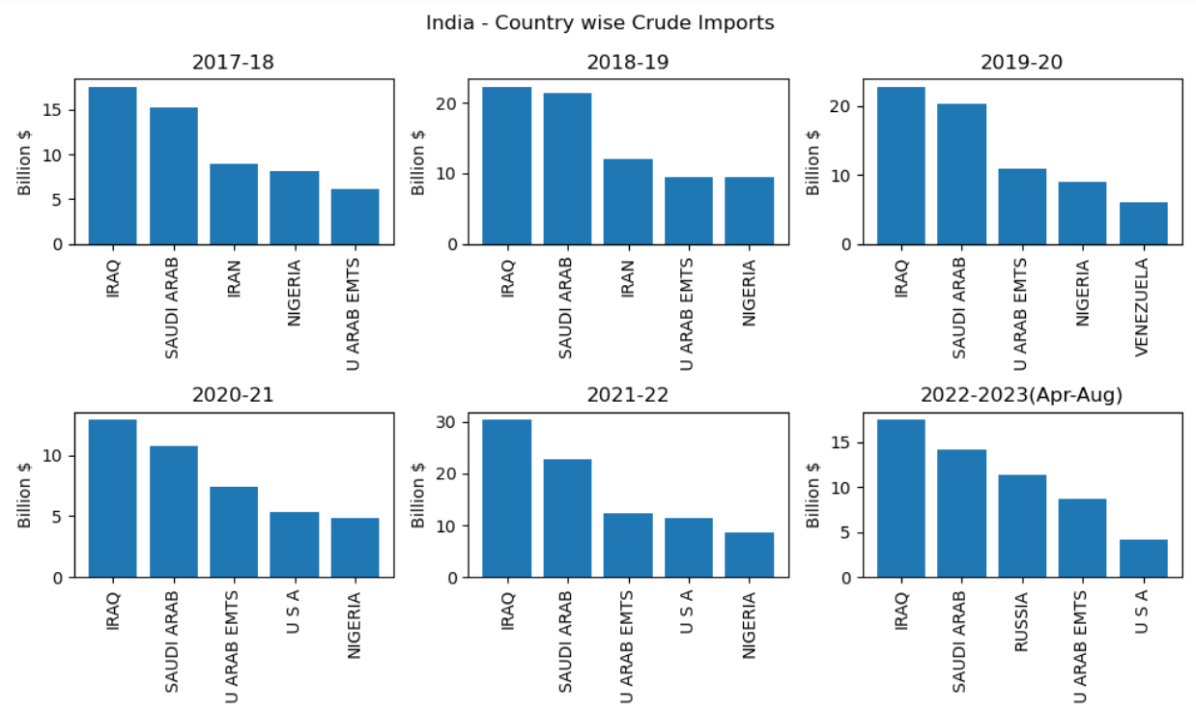
10.
Similar to EU, geographical proximity plays a role and India’s crude basket is more inclined towards the gulf region.
From being in top 5, US sanctions has led to complete halt of crude imports from Iran and Venezuela over past 2 years.
US itself has emerged as a strategic choice for crude imports in last 2 years.
While Russia was not a significant player in last 5 years, the latest jump has propelled it as 3rd largest source during Apr-Aug 2022.

Slide 16
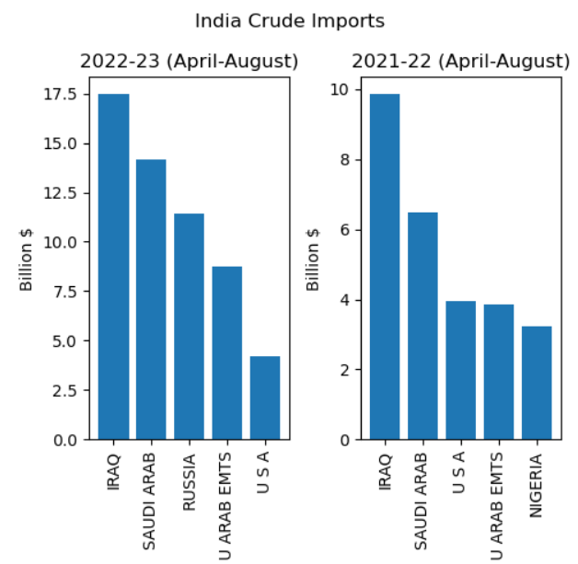
11.
Figure shows comparison between India’s crude import during Apr-Aug 2021-22 and Apr-Aug 2022-23 period. Russia is now 3rd largest source.
India’s overall crude import from Russia during whole of 2021-22 = $ 2.47 Billion, 2.01% of India’s overall crude import amounting to $ 122.45 Billion.
Russian Import during Apr-Aug 2022 = $ 11.41 Billion, 14.63% of India’s overall $ 77.96 Billion import during same period.
India has taken up Russia’s offer of deep discounts on crude after Ukraine invasion. It imported 5.7 times more Russian crude in just 5 months.

Slide 17
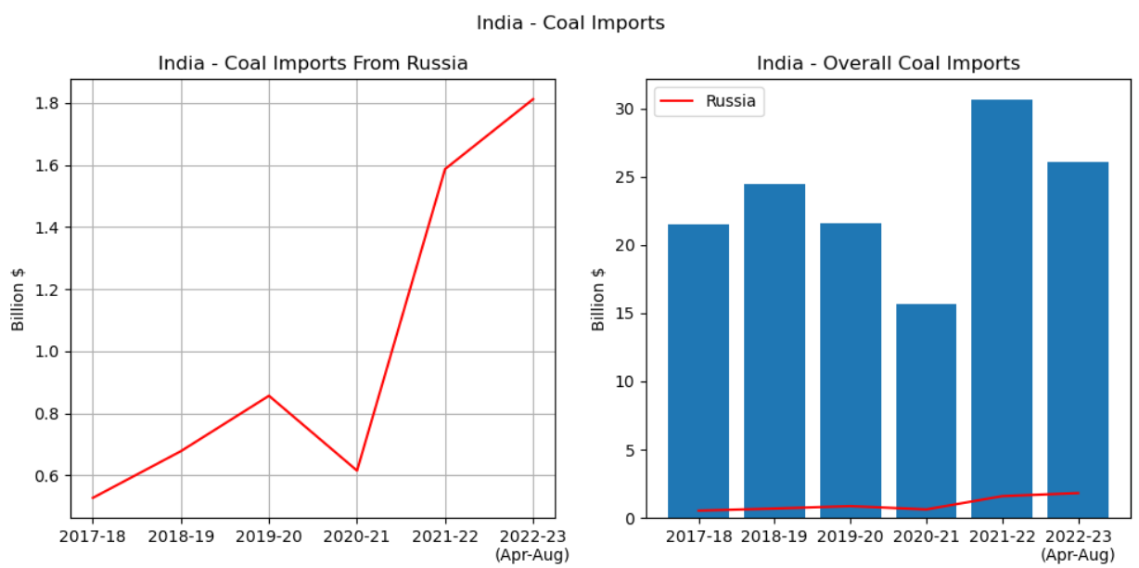
12.
Russian Coal import , which were already rising (a brief lull during Covid – 19 period not withstanding ) are now $1.81 Billion (6.95% of total )in first 5 months of FY 2022-23, 2.26 times more than $.8 Billion during pre Covid peak reached during whole of 2019-20.

Slide 18
Summary
European Union
Share of Renewable Energy in energy mix continuously while that of fossil fuel
Domestic production of primary energy consistently leading to dependency on imports.
Norway only country in Europe as net exporter of energy products in 2020.
EU heavily dependent on Russia (consistently topmost exporter) for Solid Fossil Fuel, Crude Oil and Natural Gas.
In 2020, Russia’s share of exports – 29% for Crude,43% for Natural Gas and 54% for Solid Fossil Fuel ( mostly coal.)
India
India’s primary energy needs are largely met by two fuels – coal (56.31 % ) and crude (35.53 %).
India’s crude basket more inclined towards Gulf region. Russia traditionally insignificant source.
US sanctions have led to complete halt of crude imports from traditional countries like Iran and Venezuela.
However, India taking up Russian discounted oil offer leading to 5.7 times more Russian crude in just first 5 months of FY 22-23 then whole of 2021-22. Russia now 3rd biggest source for crude.
Similarly, increase in Russian coal import. 2.26 times more in first 5 months of FY 2022-23, than pre Covid peak reached during whole of 2019-20.

Slide 19
Conclusion
Though latest figures not available, due to traditional Russian domination on EU’s energy mix and approaching winter months, a complete break or even sharp decline in Russian imports does not seem possible from EU’s point of view in foreseeable future.
This constrains EU’s options to constrict Russian exports. Shunning Russian oil and natural gas also leads to clamour towards alternate sources thereby shrinking the resource pool for other countries. Richer nations are able to pay a premium which is leading to cancellation of long term contracts and sale in spot market. Resulting inflation is already wreaking havoc in developing countries.
While historically India has not supported sanctions imposed by individual countries, in recent years, it has complied with US sanctions against its large traditional partners like Iran and Venezuela bringing crude imports from them to a stand still.
With its crude basket already shrunk, India has taken up Russian offer of discounted oil with Russia now being 3rd largest exporter of crude to India. This trend is likely to sustain given the strain on global energy markets and resulting inflationary pressures.
This sums up Indian FM’s observation that ‘All of us would like to find the right balance of our interests and values’. Still, as well wisher of both Russia and Ukraine, it is expected that India will play its part to bring this avoidable tragedy to a swift end.

